Slide 1
SBS Busness Personnel Summer Retreat
June 28, 2019
Risk Management Topics
Steve Holland
Chief Risk Officer

Slide 2
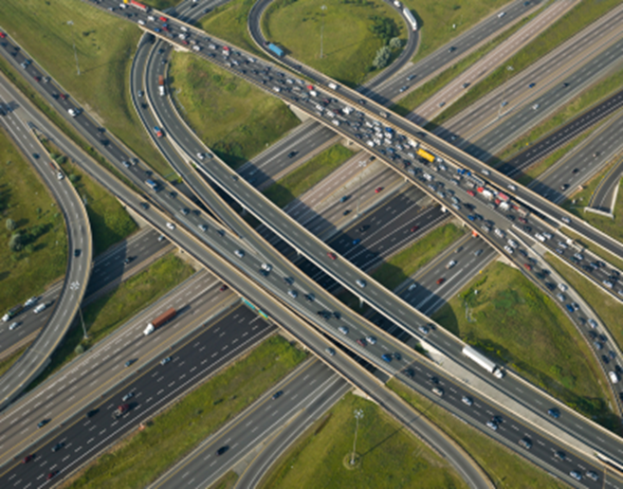
Road Map for Today’s Session
Overview of UA Risk Exposures
Ergonomics
Other Sources of Office Injury
Aren’t we Insured for That?
From the Vault - Case Histories

Slide 3

Our Primary Areas of Risk
Human
Reputational
Financial
Operational
Compliance
Strategic
Notes:
Property
Contract
Torts

Slide 4
Operational Risk Exposures
Property – buildings and contents, collections, vehicles, land, IP
Human – workplace safety, violence, EEOC, hiring/tenure/retention
Financial – revenue interruption, investment risk, penalties, uninsured loss, contractual obligations, theft
Liability – premises, events, police, student safety, compliance, vehicles, international, professional services, data breach

Slide 5
According to the Arizona Constitution, what is the maximum amount in damages that can be collected in a lawsuit against a public entity like the U of A?
$100,000
$500,000
$1,000,000
$5,000,000
$10,000,000
There is no limit on damage awards in Arizona

Slide 6
Common Questions about Liability Coverage
Can I be sued for actions and decisions made as part of my job?
    Yes
If I’m named in a lawsuit, does the UA provide me an attorney?
    Yes, legal defense is provided by the Arizona Attorney General’s Office
If I’m negligent (I messed up), am I personally liable for any loss?
    No, but could be considered a job performance issue
Under what circumstances would I NOT be covered for liability?
    Acting outside the scope of job duties and authority, criminal action
If I’m named in a lawsuit, can I keep it secret?
    No, lawsuits are public record, although both parties often agree to keep the specific terms of the settlement confidential. The amount paid is a public record.

Slide 7

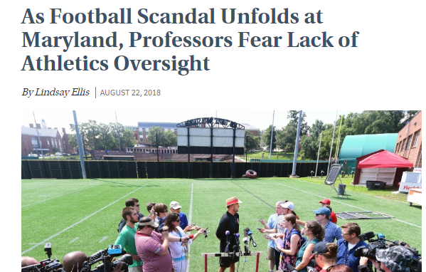
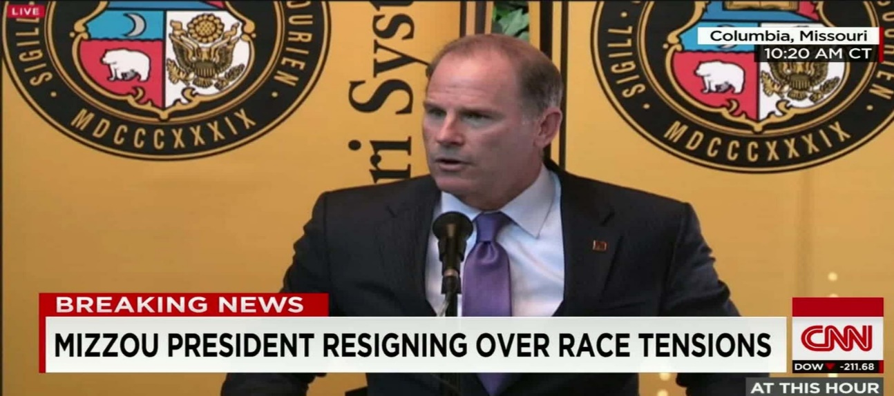
Reputational Risks in Higher Education
Program Rankings
Sexual Assault and Misconduct
Social Media
Fraud, Inadequate Internal Controls
Data Breach
Compliance Failures
Campus Violence, Law Enforcement
Academic Misconduct
Research Integrity, Human Subjects
Athletics
Environmental Issues
Deferred maintenance, campus safety

Slide 8

Compliance in Higher Education
Human Resources
Environmental Health and Safety
DOE- Title IX, Financial Aid
Information Security, Privacy
Public Safety – CLERY, Security
Athletics – NCAA
Facilities – Fire Safety, Utilities
Financial – Sponsored Projects, PCI-DSS, Tax, Financial Reporting
Research – Human Subjects, Clinical Trials, Export Control, Animals, Conflict of Interest, Animals, Select Agents,
International Activity – Banking, Defense Base Act,
Americans with Disabilities Act
Affordable Care Act, Healthcare, HIPPPA

Slide 9
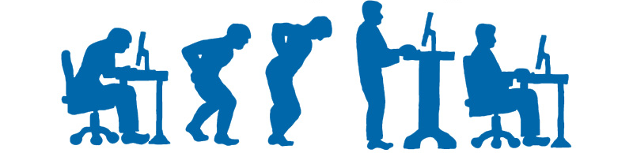

Ergonomics Awareness in the Office
University of Arizona
Risk Management Services- Lorraine Santiago

Slide 10
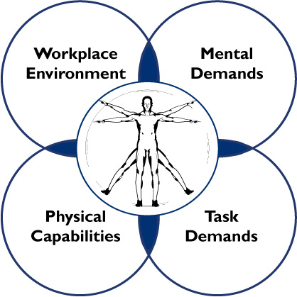
What is ergonomics?
Ergonomics is the science of designing the job to fit the worker, rather than physically forcing the worker’s body to fit the job.
Adapting tasks, work stations, tools, and equipment to fit the worker can help reduce physical stress on a worker’s body and eliminate many potentially serious, disabling work-related musculoskeletal disorders (MSDs).

Slide 11
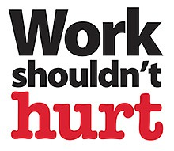
Why is ergonomics important?
Reduce the risk of musculoskeletal injuries
Want employees performing to the best of their abilities.
Musculoskeletal injuries rank among the top 10 most common in the workplace, reducing the risk of them is important
  overall worker safety
  workers' compensation costs

Slide 12
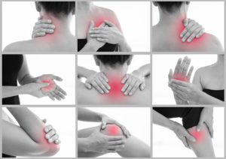
What are musculoskeletal disorders?
MSDs are occupational disorders of the soft tissues:
  muscles
  tendons
  ligaments
  joints
  blood vessels
  nerves

Slide 13
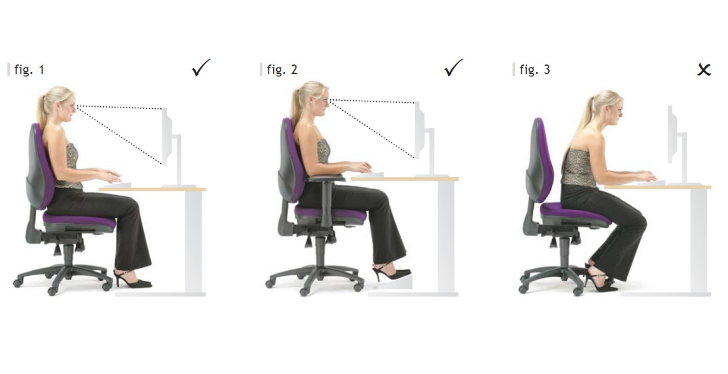
What are the causes of Musculoskeletal Disorders?
Work-related MSDs occur when the physical capabilities of the worker do not match the physical requirements of the job.
  Excessive force
  Repetitive movements
  Awkward postures
  Static postures
  Motion
  Compression
  Lack of breaks
  Working in cold temperatures
  Body vibration
Notes:
Highlighted in red: Most common in office

Slide 14
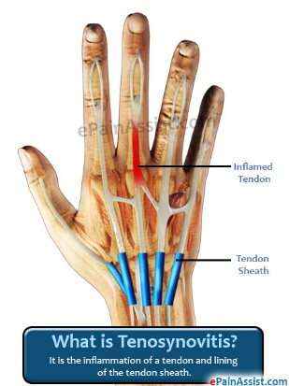
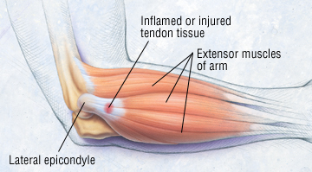
Occupational disorders & Symptoms
Tendonitis/Tenosynovitis
Epicondylitis (tennis/golfer elbow)
Inflammation of a tendon
Risk Factors
  Repetitive wrist motions
  Repetitive shoulder motions
  Sustained hyper extension of arms
  Prolonged load on shoulders
Symptoms
  Pain, weakness, swelling, burning sensation or dull ache over affected area
Condition of the elbow caused by overuse
Risk Factors
  Repeated or forceful rotation of the forearm and bending of the wrist at the same time
Symptoms
  Same symptoms as tendonitis

Slide 15
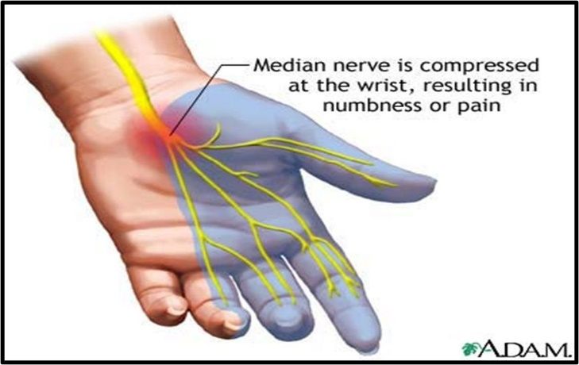
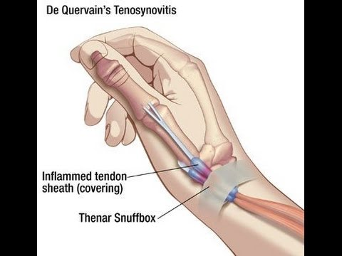
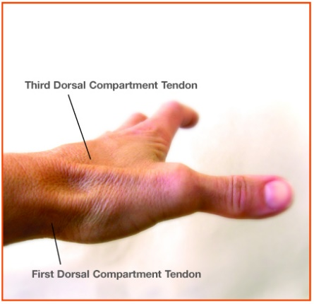
Symptoms & Occupational disorders
Carpal tunnel syndrome
DeQuervain’s Disease
Pressure in the median nerve in your wrist
Risk Factors
  Repetitive wrist motions
Symptoms
  Pain, numbness, tingling, burning sensations, wasting of muscles at base of thumb, dry palm
Painful inflammation of tendons in the thumb that extend to the wrist.
Risk Factors
  Repetitive Hand twisting and forceful gripping
Symptoms
  Pain at the base of the thumb

Slide 16
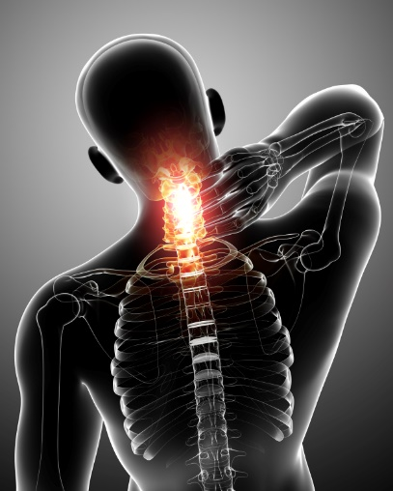
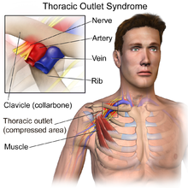
Symptoms & Occupational disorders
Thoracic Outlet Syndrome
Tension Neck Syndrome
Compression of nerves that pass into the arms from the neck
Risk Factors
  Prolonged shoulder flexion
  Extending arms above shoulder height
  Carrying loads on the shoulders
Symptoms
  Pain, numbness, swelling of the hands
Pain in the neck and shoulder area
Risk Factors
  Prolonged restricted posture
Symptoms
  Pain or stiffness in the cervical vine in the neck
  Limited neck movement

Slide 17
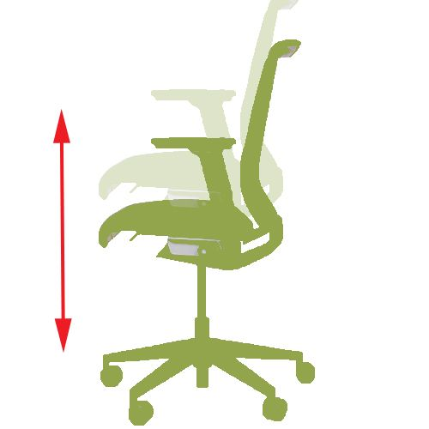
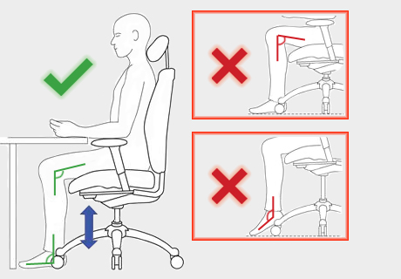
Chair adjustments
Seat Height Adjustment
  This is the first thing you will always want to adjust.
  It will allow you to position yourself at the correct height for your workstation.

Slide 18
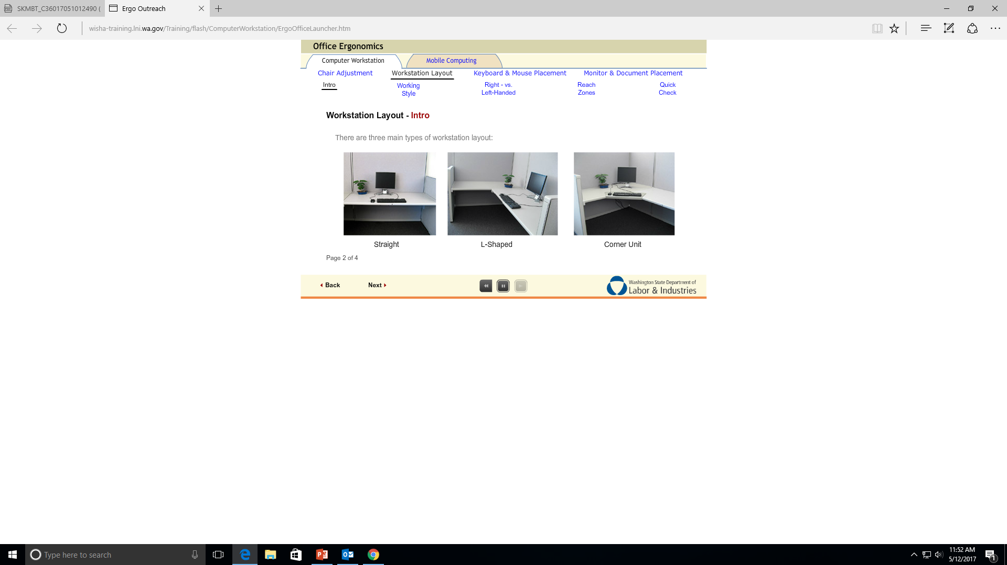
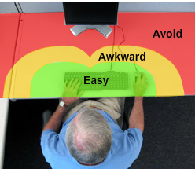
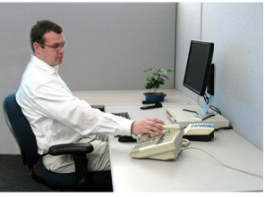
Workstation Adjustments
Your workstation layout should fit your height, your reach, and the way you work.
You should work at your desk without reaching too far, bending or twisting.
Notes:
If you mainly use the computer, just about any workstation work for you.
It does not matter if the keyboard is in a keyboard tray or on top of your desk, the important thing is that it is at the correct height for you.
If you do other things rather than being ion the computer, like using your phone. It may cause that you excessively reach out and do an awkward posture. It may be better off that you put your keyboard in top of your deksk so that a keyboard tray is not on the way.

Slide 19
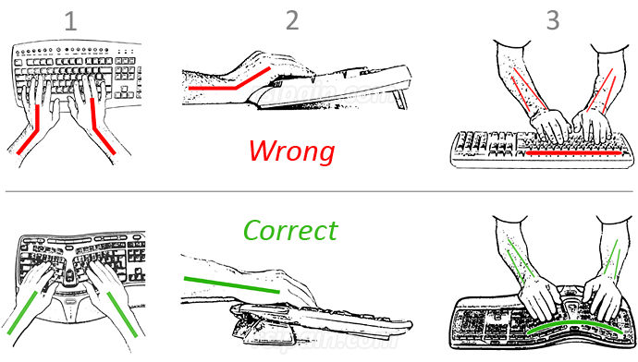
Keyboard and Mouse Placement
Important things to notice while placing your mouse and keyboard
  Keyboard height, tilt and distance
    Too high: Raise your chair, and use footrest
    Too Low: Raise your desk
    Keep elbows next to your body
Notes:
Keyboard at correct height: will keep your wrist straight and elbows relaxed
Make sure to have your chair adjusted before adjusting anything else.
Keyboard too high: Raise your chair and use a footrest for support
Keyboard too low: Raise your desk an place it on risers.
Sit with your elbows back and your arms to your side.

Slide 20
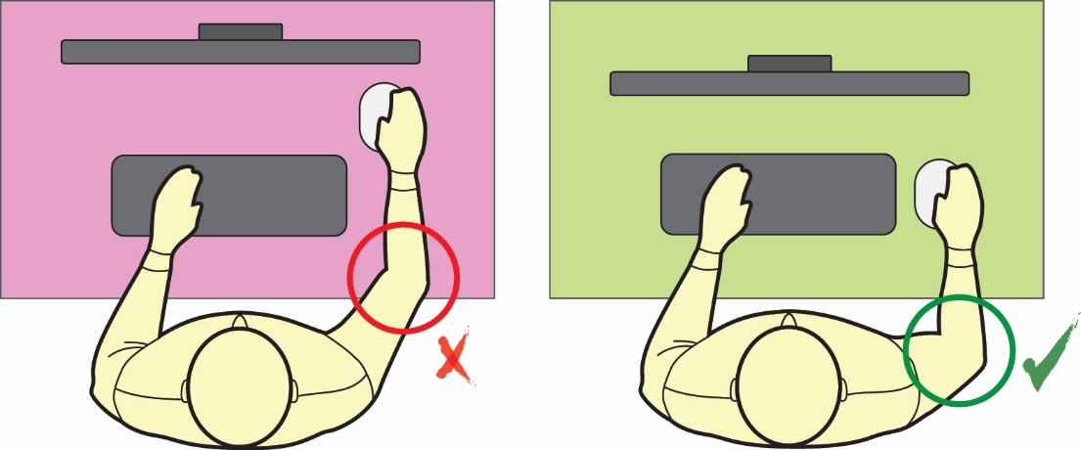
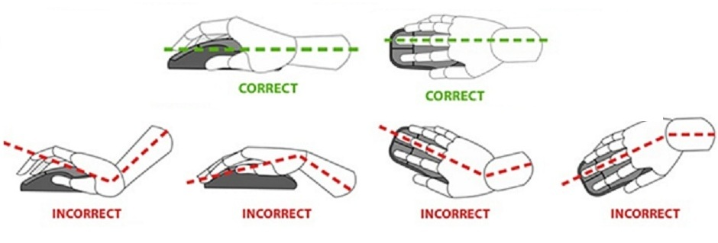
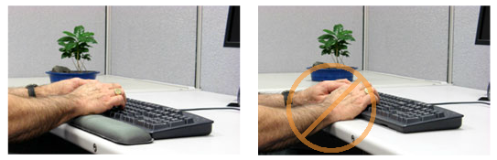
Keyboard and Mouse Placement
Important things to notice while placing your mouse and keyboard
  Mouse Placement
    Place it at elbow height
    Place your palms on the rest, not your wrists.
    Keep your wrists straight.
Notes:
The mouse should be at the same. height as the keyboard
*Try using a keyboard without a number pad.
*Place your palms on the rest, not your wrists.
*A wrist wrest is not recommended. This can lead to people resting their palms on the rest and moving their wrists from side to side for using the mouse. This could lead to wrist injury.
*It is much better to support your forearm on your arm rest or on your desk.

Slide 21
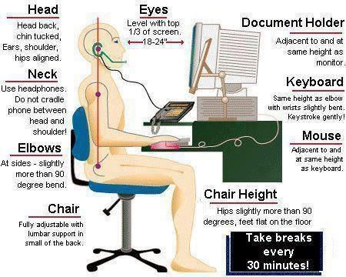
Re-CAP

Slide 22
If you would like an ergonomic or safety evaluation of your workspace:
John Murphy, CSP, Manager of Industrial Hygiene Programs 621-4551
Lorraine Santiago CIH, Industrial Hygienist 621-3585
Julia Rosen CIH, Sr. Industrial Hygienist 621-1570
Charity Madrid-Torres, Health/Safety Specialist 626-1136
Israel Selwick, Health/Safety Specialist 626-1049
Find RMS online at: https://risk.arizona.edu/
Research Laboratory Safety Services: https://rgw.arizona.edu/compliance/RLSS
Occupational Health Program: https://occhealth.arizona.edu/home

Slide 23
Other Sources of Office Injury
Slip, Trip, & Fall
  high heel shoes, sandals, torn carpeting, tripping hazards, stairs, wet floor, weather, walking while texting
Lifting Injuries
  copier paper, drinking water, food
Rolling Chairs
  standing on chair, missing chair when sitting, falling backward
Indoor Air Quality (IAQ)
  perfume, vehicle exhaust, maintenance/renovation, mold
Personal Security
  domestic violence, sexual assault, robbery

Slide 24
How is the UA insured against loss?
ARS §41-621 The Arizona Department of Administration – Risk Management Division – more affectionately known as State Risk Management – administers property, liability, and worker’s compensation for all state agencies, including the universities.
Coverage is defined by statute, and further refined in the Arizona Administrative Code R2-10 – Articles 1-5
State agencies pay “premiums” through a cost allocation system based on agency exposure information, loss history, and actuarial projections.
Property and liability charges are paid at the start of the fiscal year. Worker’s compensation premiums are calculated against actual payroll expense, and paid throughout the year.

Slide 25

CLAIM OR NO CLAIM???
Public tours of the Biosphere 2 facility include walking outdoors between buildings. A patron visiting with his family was stung by a bee, had an allergic reaction, and went into anaphylactic shock. After several minutes, 9-1-1 was called, and due to the remote nature of the facility, the victim was airlifted by helicopter to a hospital for treatment, where he made a full recovery. There were no epi-pens on site, and the victim’s family watched him lying on the ground convulsing and struggling to breathe while awaiting emergency medical assistance.
Denied

Slide 26

CLAIM OR NO CLAIM???
The ticket sales window at McKale Center is outdoors, adjacent to a wide sidewalk area. Next to the sidewalk is metered parking for the ticket sales office, adjacent to a campus street. A group of patrons was standing in line, including a mother who had two young children playing nearby. While she was at the ticket window, a golf cart was driven through the area on the sidewalk. The cart struck her 3-year old son and dragged him underneath for about 15 feet before coming to a stop. The mother, older brother, and several patrons witnessed the incident. Fortunately, the little boy suffered only scrapes and bruises.

Slide 27
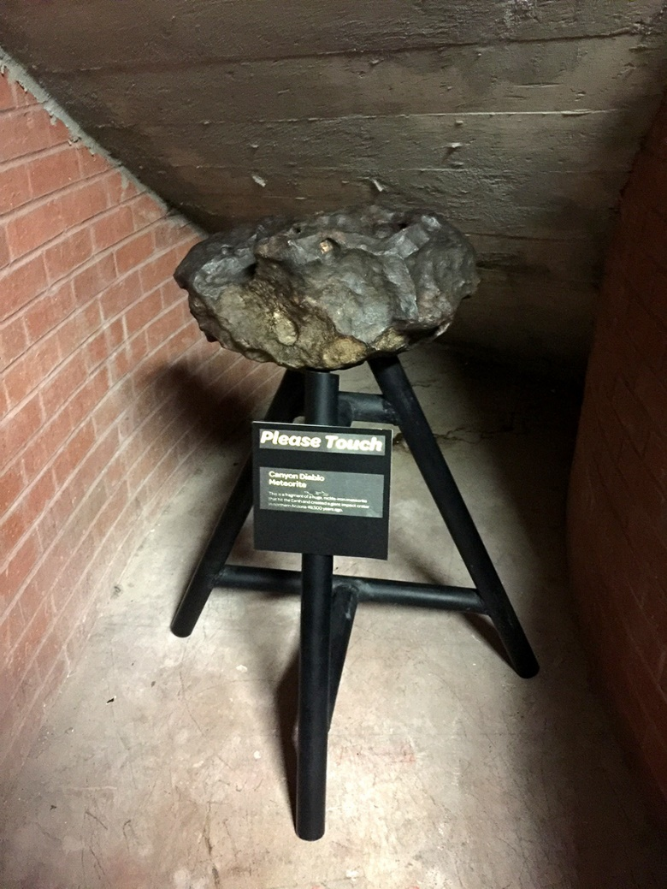
CLAIM OR NO CLAIM???
As part of a disciplinary action, a male undergraduate student was assigned to perform community service on campus at the Flandrau Science Center. A 225 lb. meteorite was on display, welded to three metal legs which were configured as a tripod stand. A sign next to the meteorite said “Please Touch” to encourage patrons to feel the surface of the piece. The student picked up the meteorite and its stand so his friends could take a picture. He lost his balance, fell backwards, and as he hit the floor the meteorite severed two of his fingers. Museum staff called 9-1-1, and emergency surgery was done to attempt re-attachment of his fingers.
Claim and Lawsuit, Defense Verdict (we won)

Slide 28
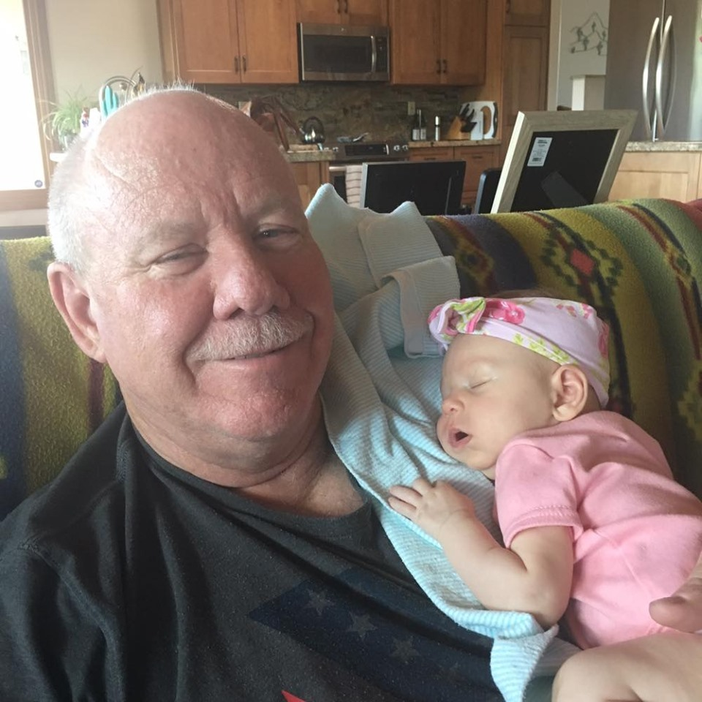
Thank you!
Steve Holland
520-621-1790
sholland@email.arizona.edu

