Slide 1
Introduction to Sponsored Projects & Contracting Services
Notes:
Opening Questions:
Show of hands: Faculty or staff working on a sponsored project? RA support for Investigator? Dept RA? College RA? Other?
What interaction have you had or would you expect with SPCS?
Goal: Awareness of the ways in which Sponsored Projects Services supports the research mission of the UA.
Recognize the areas of SPCS support.
Identify for yourself which of these areas you might need to contact.
Know how to contact SPCS.

Slide 2
Where does the funding come from?
  Congressionally appropriated funds for basic research
  Private foundations
  Federal contracts for specific work
  Private industry contracts for specific work

Slide 3
How is the funding found?
  RFPs on Federal Agency Websites
      www.nsf.gov
      www.nih.gov
      http://www.csrees.usda.gov/
  Grants.gov
  Community of Science
  Websites of for-profits and non-profits

Slide 4
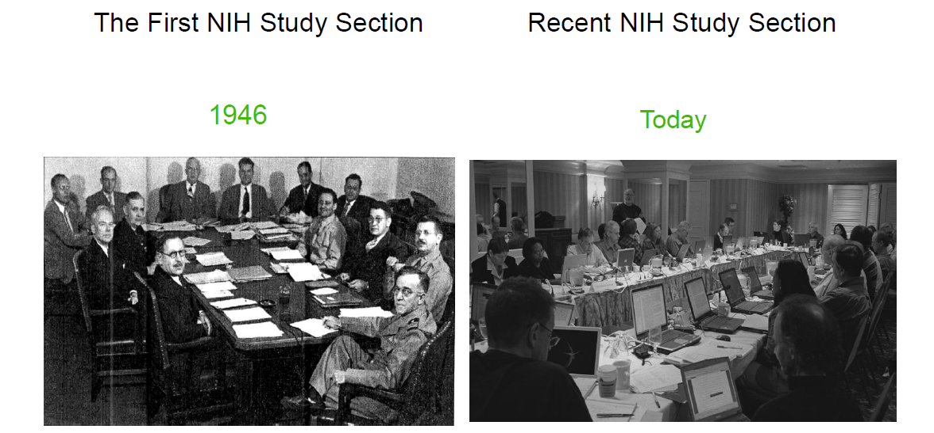
Agency Review of a Proposal
Notes:
Be focused and keep it simple
➢Make your logic/rationale clear
➢FIND MENTORS!!
➢Proofread!! Have zerotolerance for typographical errors, misspellings, or sloppy formatting
➢Have others read what you have written
➢Reread what you’ve written after taking a break
Your written proposal represents YOU to the reviewer and is the only way (s)he knows what you are thinking!

Slide 5
Research Funding
For FY 2017, what was UA’s research expenditure total (including both sponsored and institutionally funded research)
  478 million
  622 million
  800 million
Notes:
478 – 2004
622 – 2017
800 – 2025 goal

Slide 6
Research at UA
2017 research expenditure breakdown
  273m Federal
  20m State and Local Govt
  187m Institutional Funds
  12m Industry
  35m Nonprofit
  94m Other sources https://uair.arizona.edu/content/rd-expenditures

Slide 7
Federal Agencies and UA funding
Dept of Defense – 23m
Dept of Energy – 14m
Health and Human Services – 108m
NASA – 43m
National Science Foundation - 56m
US Dept of Agriculture – 12m

Slide 8
Sponsored Projects & Contracting Services (SPCS)
Why is SPCS here?
Support & guidance for UA Investigators
Managing risk to protect investigators and the University
Notes:
UA faculty applying for, and receiving external funds
Avoid hassles by engaging SPCS before there is:
Duplicate work to revise an application and/or budget
Lengthy negotiations to remove unacceptable clauses
Insurance/liability/resource/tax issues
Noncompliance with financial requirements
Unallowable expenditures

Slide 9
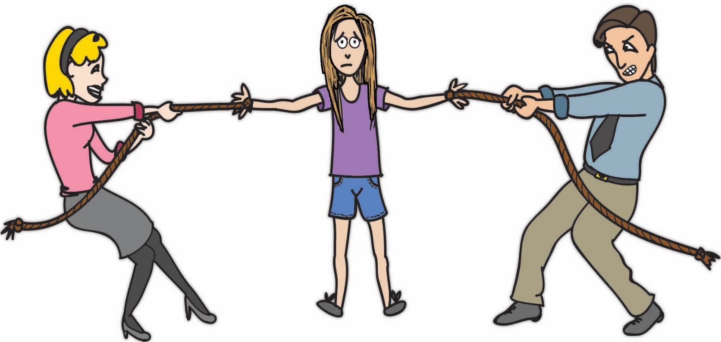
Paradigm of Stewardship
Innovation Researcher Stewardship
Notes:
Faculty burden ask audience to answer question to each other -40% spent on admin tasks per FDP
Our role is to mitigate the effects of administrative burden on faculty

Slide 10
Who is Sponsored Projects & Contracting Services?
SPCS
Preaward
Postaward
Proposal
Team 1
Compliance,
Audit, Property,
Subrecipient Monitoring
Contracting
Team 2
Award
Team 3
Subaward
(Outgoing)
Team 4
Notes:
We’ll cover 2 main support areas & how SPCS works with the UA research community. Michael will discuss contracting after I finish.
PreAward:
Review/Approval of proposals
Award/contract negotiations
Intake of grants & contracts
Postaward:
Teams work with specific colleges
Cost Sharing/Effort Reporting
Property
Audit/Quality Assurance
Outgoing Subawards

Slide 11
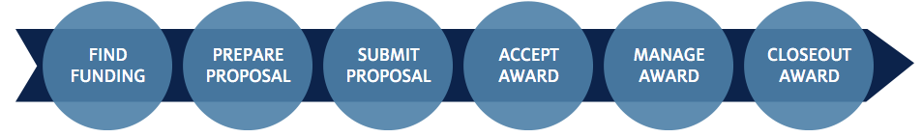
Preaward: Proposal Services
“3-Day Deadline”
  Late Proposal Request web form rgw.arizona.edu
  Dean approval required for Late Proposal Requests
Application and sponsor instructions
Institutional review
UAccess Research (UAR) online routing assistance
Authorized final approval/submission
Notes:
SPCS institutional review includes:
Online (UAR) proposal (details & approvals)
Required sponsor forms (data & completeness)
Project lay abstract (for activity type and compliance)
Budget & Justification (allowability of costs)
Other forms, support documentation if applicable
3-day internal proposal deadline - SPCS will submit on time if you give us 3 full business days before sponsor deadline:
Fully approved proposal in UAccess Research (UAR)
Ready to submit - complete application, ready for e-submission or authorized signature (paper proposals)

Slide 12
Preaward: Proposal Services
In FY18
3,570 total proposals submitted
77.65% New Proposals
44% Federal sponsors
https://uair.arizona.edu/content/sponsored-awards-proposals

Slide 13
Proposal Approvals – Why?
Department and College
  Effort and resources
  Department & UA missions
      SPCS (Sponsored Projects & Contracting Services)
        Assurance of compliance
        Sponsor regulations and University policies
              RDI (Research, Discovery & Innovation)
                Institutional cost sharing
                F&A waivers (overhead, Facilities & Admin.)
Notes:
Department and College Approvals
Effort and Resource Commitment
Department and/or college cost sharing
Project is consistent w/ dept & institutional mission
F&A Waiver requests, where applicable
SPCS Approval
Assurance of compliance w/ sponsor regulations and university policies
RDI Approvals (only if needed)
Institutional cost sharing
F&A waivers (8 business days before the sponsor deadline)

Slide 14
Preaward: Award Services
Award intake
(SPCS Contracting Services signs)
Verify proposal approvals
COI compliance (Conflict of Interest)
Record awards in UAccess Research
“Department Hold”
Remember to route a UAR proposal
Notes:
Sponsored Projects Services & Contracting Services
Award intake (Award Services/Contracting Services)
Initial review
Unilateral grants – Award Services
Bilateral awards – Contracting Services
Ensure proposal was routed (Award Services/Contracting Services)
PI/Department routing
Dates and Amounts are accurate
Compliance checks, COI, E-Verify, Confidential Info
Complete award negotiation (Contracting Services)
Only authorized delegates can sign (Contracting Services)
Record award and set up account (Award Services)

Slide 15
Types of Agreements
  Assistance
    Grants
    Cooperative Agreements
  Procurement
    Contracts
      Cost Reimbursement
      Fixed Price
Notes:
Mention contracting has their own session that describes this as well

Slide 16
Award documents and signature
    Unilateral award (does not require signatures)
      Most are grants, coop agreements

Slide 17
Award documents and signature
    Bilateral awards (require signatures)
      Contracts
        Also requires PI approval

Slide 18
Why does that matter?
Processing time?
    Unilateral awards are generally assistance agreements that are easier to process and setup
    Bilateral awards are generally deliverable based, specific, and require negotiation from both parties

Slide 19
Preaward: Contracting Services
What do you think of when I say “negotiation”?
What comes to mind?

Slide 20


Slide 21
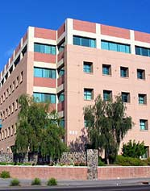
Contracting Services
Reviews & negotiates incoming research grants and contracts requiring signature behalf of the University of Arizona
Advise PI’s and departments of the inherent risks written into the agreement

Slide 22
Contracting Services
Who Negotiates Contracts at UA?
Sponsored Projects & Contracting Services
Handles all contracts that involve money coming TO the University
Procurement & Contracting Services (PACS)
Handles all contracts that involve money going OUT of the University
Outgoing Subawards
Subawards related to a sponsored award
UAHS Research Administration
All sponsored contracts associated with a UAHS Principal Investigator

Slide 23

Contracting Services
SPCS
PACS
$
in
$
out
UAHS
RA
Subawards

Slide 24
Contracting Services
Grants Contracts Clinical Trials (UAHS)
Material Transfer Agreements Data Use Agreements
Confidentiality/Non-Disclosure Agreements
Testing/Professional Services
Memoranda of Understanding Intergovernmental Agreements
Teaming Agreements Student Experience Agreements
Museum of Art/Center for Creative Photography Agreements

Slide 25
Issues in Negotiation
Indemnification
Intellectual Property
Data Ownership
UA is prevented from indemnifying the sponsor or other third parties in most cases.
University Intellectual Property, regardless of the source of funding, is generally the property of the University. Options to license are available in the agreement.
UA should retain ownership of all original/raw data. The sponsor may use the UA’s deliverables or reports.
Notes:
Many of these “issues” have waiver processes or are discussed with the PI and Department. None of them are particularly showstoppers that will terminate a negotiation.

Slide 26
Issues in Negotiation
Publication
Governing Law
As a body corporate of the State of Arizona, the University cannot agree to be governed by the laws of another state or country.
UA must be able to freely disseminate/publish results without restrictions. UA will acknowledge an sponsor’s financial or material contribution.

Slide 27
Issues in Negotiation
Confidentiality
Mandatory
Clauses
* Equal Opportunity and non-discrimination
* Arbitration
* Conflict of Interest
* State Appropriation of Funds
Arizona has a very broad Public Records Act which requires almost everything we do be open to public inspection.

Slide 28
Tips
Email an editable version of the agreement to
contracting@email.arizona.edu
Use the Contract Submission Cover Sheet
* UAccess Proposal Doc # * Email contact information of the Sponsor
* Deadlines for execution * Unacceptable terms or errors
Notes:
Contract Submission Cover Sheet can be downloaded from the Research Gateway, "Forms and Templates" page, under "Contracting"

Slide 29
Subawards
  Outgoing subawards
    Welcome letter
    Negotiation & obtain partially signed agreement and compliance
    Notify department to initiate requisition
    Send fully executed to subawardee and dept.
Notes:
Outgoing Subawards – proactive set-up and ongoing maintenance

Slide 30
Postaward Services (Fund Accountant Teams)
Account set up
Invoices and financial reports
Financial oversight and guidance – approvals
Closeout
Timeliness is key!
  Expenses,
  Reports
  Closeout
Notes:
Oversight and compliance support:
Account Setup/Modification
Invoicing and cash management
Financial Reporting
Budget & Cost Monitoring
Navigating Sponsor regulations
Monitoring/reporting cost sharing
Approvals:
Account Changes
Expenditures
Cost Transfers

Slide 31
Compliance
  Effort reporting, Supplemental Compensation
  Cost sharing, NIH Salary Cap
  Property
  Audit coordination, Reporting
  Subaward subrecipient monitoring
Notes:
Compliance is an ongoing focus even after the project ends
Cost Sharing – periodic financial reports, audits
Effort Reporting every 6 months
Property – title and reporting
Audit - during and after project end
Quality Assurance is ongoing
Subawards –

Slide 32
Common Issues Recap
Preaward:
  Proposal routing (3-day deadline)
  “Department hold” for awards
Postaward:
  Timely and justified expenditures
  Technical/Progress reporting
Notes:
These are areas where you can be part of the solution, not part of a problem.

Slide 33
Let’s work together!
Preaward:
  Involve supporters early when you have a proposal
  Plan time for routing (3-day deadline)
  Send award documents as soon as you get them
Notes:
Preaward:
Read the funding announcement and ask questions
Involve supporters early when you have a proposal
Plan for routing deadlines (3-day deadline)
Send award documents as soon as you get them

Slide 34
Let’s work together!
Postaward:
  Review award T&Cs – find relevant regulations
  Before a purchase: is it reasonable, allocable, consistent?
  Document the purchase well, especially unusual purchases
  Contact your SPCS fund accountant for guidance
Notes:
Preaward:
Read the funding announcement and ask questions
Involve supporters early when you have a proposal
Plan for routing deadlines (3-day deadline)
Send award documents as soon as you get them
Postaward:
Review award T&Cs & know where to find relevant regulations
Before a purchase: is it reasonable, allocable, and consistent?
Contact SPCS fund accountant for guidance

Slide 35
SPCS Training and Outreach
Monthly UA Research Admin Forum
Online Learning
Call us for custom training via web call
https://rgw.arizona.edu/research-resources/training/administrators

Slide 36
SPCS is here to help!
Sponsored Projects & Contracting Services (SPCS):
  Phone: 626-6000
  E-mail: sponsor@email.arizona.edu
The Research Gateway website at rgw.arizona.edu
Notes:
RGW includes: user guides, explanations, UAccess Research videos

