Slide 1
Program Fee & Differential Tuition (PFDT) Orientation
Academic Administration and
University Analytics & Institutional Research
September 19, 2019

Slide 2
INTRODUCTION

Slide 3
AGENDA
NEWS
PFDT DASHBOARD
PFDT YEAR-END REPORTING
FINANCIAL AID CONSIDERATIONS
LEASONS LEARNED & BEST PRACTICES
ABOR UPDATE
LIVE DEMONSTRATION

Slide 4
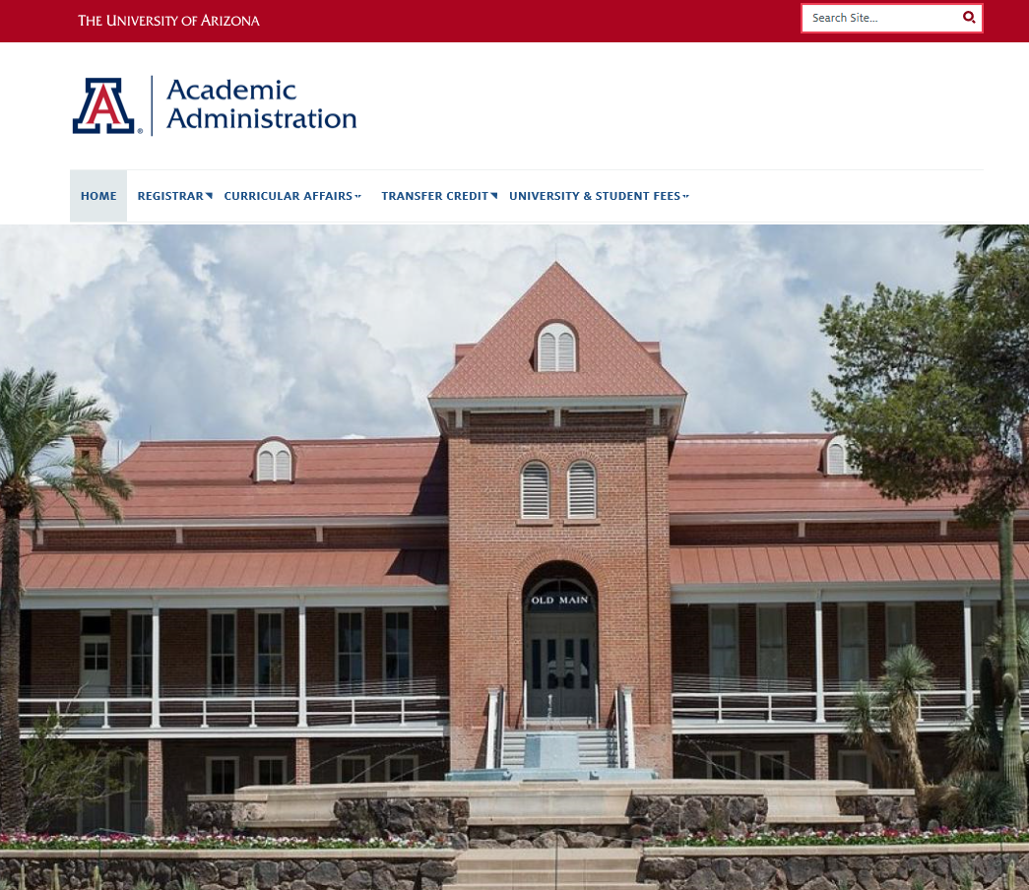
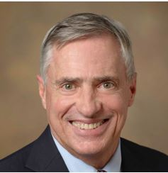
NEWS
New Leadership
Associate Vice Provost for Academic Administration – Dr. Greg L. Heileman
Professor of Electrical and Computer Engineering (since 1990).
HED Administration since 2004
University of Kentucky and University of New Mexico
University of Central Florida – PhD
New Website

Slide 5
PFDT DASHBOARD
UAccess Analytics>
Dashboards>
Student>
Course and Fee Management>
Program Fees and Differential Tuition (tab)>

Slide 6
PFDT OVERVIEW
Actuals
Budget vs Actuals
Budget Balance + Encumbrances
Allocation from Net Revenues
Income vs Expense Trend
Expenditure by Category Trend
Notifications

Slide 7
PFDT OVERVIEW cont.
Financial Management
Beginning Balance
Income
Expense
Current Balance
% of Usage
FAS Management
Students Awarded YTD
Awarded YTD amount
Available to Award
Pending Disbursement
Disbursed amount YTD
Fee Management
Students Charged YTD
Charged to Students
Outstanding amount
Avg. Charge / student

Slide 8
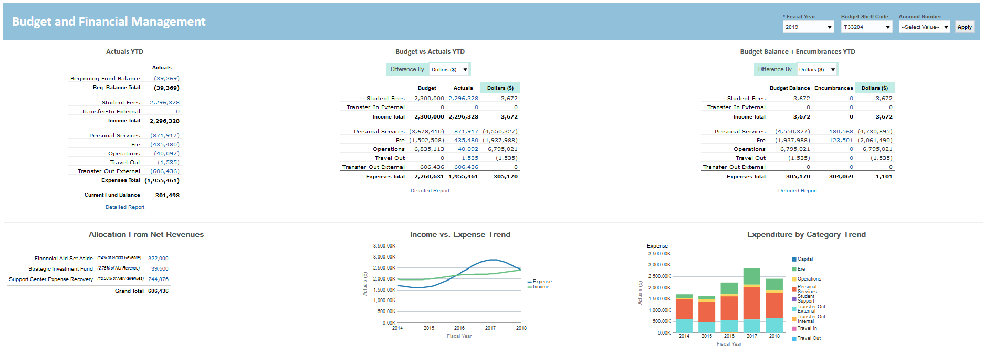
BUDGET & FINANCIALS
Actuals & Budget
Actuals YTD (Categories)
Budget Vs. Actuals YTD
Budget Balance + Encumbrances YTD
Visuals
Allocations from Net Revenue
Income Vs. Expenses Trend
Expenditures by Category Trend

Slide 9
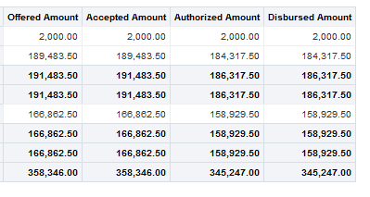
Financial Aid Set Aside – Student Awards
View Capabilities
Summary by Account Org
Summary by Student/ Aid Year
Summary by Account Rollup

Slide 10
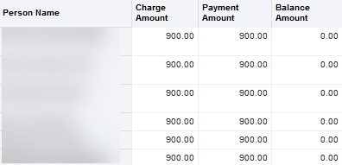
Charges & Payments
Totals at College Level & Per Student
Charged Amount
Payment Amount
Balance Amount

Slide 11
Over/ Under Realized Revenue
Budget Report
Current YR Budget
Total Income & Transfer In
Variance
FAS Adj
Support Center Expense Recovery (SCR)
Strategic Investment Fund (SIF)
Ops Adj

Slide 12
Year-End Reporting
DEADLINE OCTOBER 25, 2019

Slide 13
Year-End Reporting
Balance Report – Budget Shell Code
Pre-Populated Form
Verify Data - Correct fiscal year
One form for each PFDT
Attach any additional pages
Justification & Narrative
Signatures

Slide 14
PFDT: Financial Aid Considerations
Notes:
Do you know how to determine if a student shows financial need? Do you know if a disbursement (external award) failed? Come to this presentation for strategies on effective student award management.

Slide 15
Determining Need
COA – EFC = NEED
Financial aid eligibility is the difference between the Cost of Attendance (COA) and the Expected Family Contribution (EFC).
A federal formula performs the needs analysis to determine the EFC.
Cost of attendance includes tuition and fees, room and board, books and miscellaneous expenses, and is an estimated value. Estimates are listed on the OSFA website.

Slide 16
UAccess Analytics
Student Fin Aid & Fin Details Dashboard
Determining Student Need Report
Getting to the report:
Analytics > Dashboards > Student > Student Fin Aid & Fin Details

Slide 17
Determining Student Need
Report Screenshot:
Notes:
Default Prompts :
Current Aid Year
EFC “Official” Status – Estimated Family Contribution
Current Term
Student Plan Code = TTEPHD (Teaching & Teacher Education)

Slide 18
Determining Student Need
Reading the Report:
Notes:
The three rows of data tell three different stories for three different students.
A closer look at the left side columns
Line 1: Student has no need after gift aid and federal need because EFC > COA
Line 2: Student has EFC>0
Line 3: Student EFC = 0

Slide 19
Check on Award Status
UAccess Analytics
Student Award Report
Getting to the report: One option is through the PFDT dashboard or
Analytics > Dashboards > Student > Student Awards

Slide 20
Student Award
Using the Report Prompts:
Can enter list of SIDs, KFS or item types
Notes:
Recommended:
search by Student Code, Student Plan, or Student Department
Department also gives you Masters, PHD, Grad, and Undergrad

Slide 21
Multiple Awards
We are required to follow the rules for the most restrictive award.
Set-Aside has “highly restrictive” rules, all other aid on a student’s account must follow these restrictions if a student is awarded set-aside. This includes, but is not limited to:
Merit scholarships
Donor scholarships
Subsidized loans

Slide 22
Changes to Awards
Loan Reduction
Though not always intended, loan reduction is a POSITIVE outcome to awarding scholarships/grants.
Students are given an opportunity to appeal.
If a loan has not been accepted, we will automatically reduce unaccepted loan.

Slide 23
Notifying Students of Set-aside Award
Emails to students should include:
Deadline for disbursement
FAFSA filing requirement/demonstrating need
Disclaimer that an award can be canceled if student changes programs, reduces enrollment, or receives additional awards
Students must be meeting Satisfactory Academic Progress as calculated by OSFA
Loan and Federal Work-Study eligibility may be reduced

Slide 24
Lessons Learned & Best Practices
Budget Shell Code %
Approved Expenditures
Financial Aid Set Aside (FAS)
Encumbrance
22

Slide 25
ABOR Update
Differential Tuition
New College Fee option
Performance Audit
Sunset review
10 Year plan to review all fees
Fee Requests Deadline
December 1, 2019 for AY 2020-2021 Fees
23

Slide 26
Dashboard Demonstration
24

Slide 27
Contact Information
Martha Sesteaga, University Fees Program Manager
sesteaga@email.arizona.edu
(520) 621-3046
Eddie Caratachea, Business Intelligence Developer
eddiec@email.arizona.edu
(520) 626-1140
25

