Slide 1
Training your
e. Y. e.
Burnout
to prevent
Bob Cunningham, MS, LPC
Notes:
Google
$300 - $350 B/ year
WHO – Occupational Phenomenon
Shortcomings – Agreement and non-agreement
Deeper Research
The e.Y.e.
Based on indiv. sessions

Slide 2
Studying Burnout
Developed in 1981 by Dr. Christina Maslach
The most widely utilized and validated instrument for measuring burnout.
4 different versions
Maslach Burnout Inventory

Slide 3
Studying Burnout
Some other surveys/instuments used to measure burnout:
Bergen Burnout Inventory
Oldenburg Burnout Inventory
Shirom-Melamed Burnout Measure
Copenhagen Burnout Inventory
Spanish Burnout Inventory
Common Element in all:
Exhaustion

Slide 4
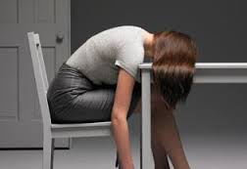
Burnout Defined….
From the Journal on Burnout Research (2014):
Burnout is a syndrome characterized by:
Lack of personal
accomplishment
Exhaustion
Cynicism
Depersonalization
Physical &
Mental
Overall negative view of work
A sense that work is not meaningful or lack of efficacy
Emotionally “fried” or
Zombie-mode

Slide 5
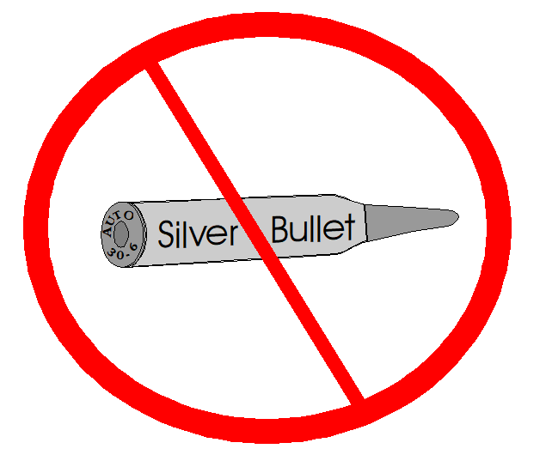

Slide 6
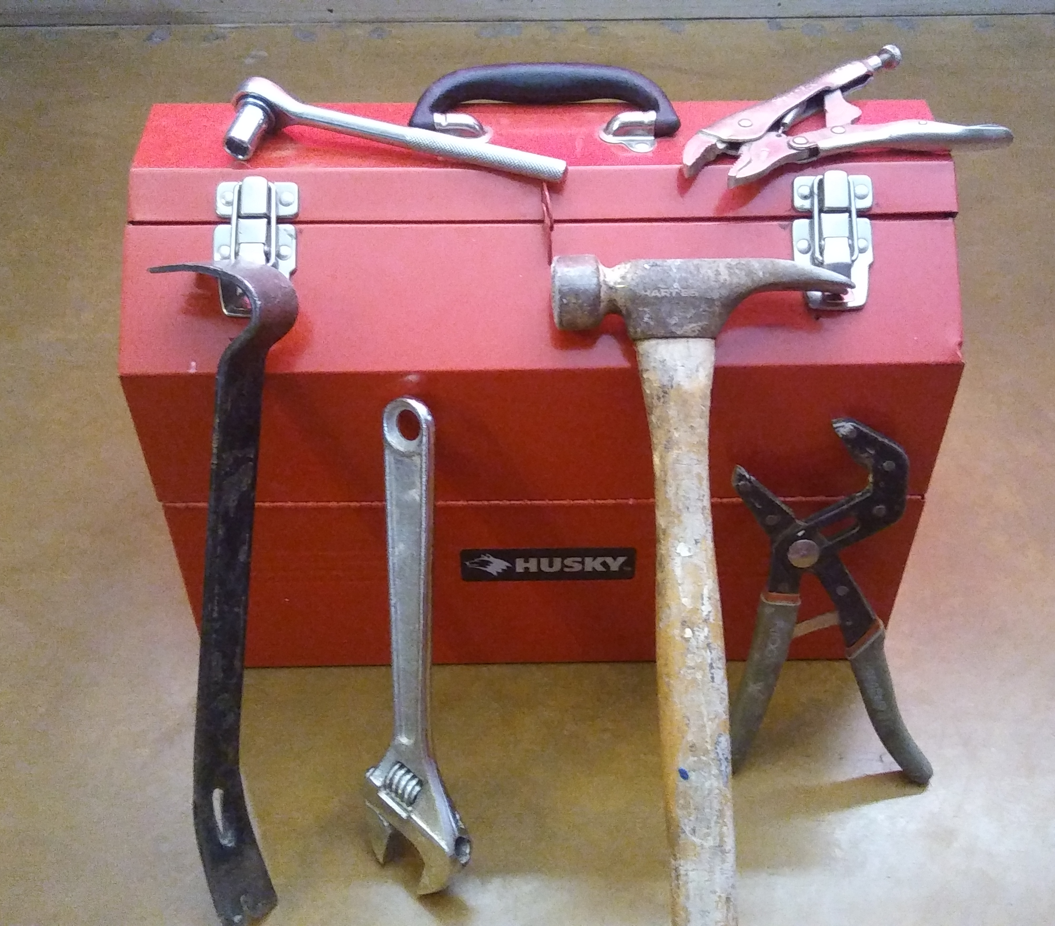

Slide 7
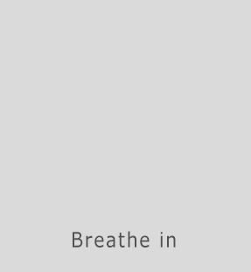
It’s free….
It’s abundant….
It’s everywhere!
And if used properly,
it can help to calm and
focus you.
Notes:
Introducing….A close personal friend of mine and yours….

Slide 8
e. Y. e.
So what is this stuff anyway….?
e. Y. e.
Connecting with, supporting and caring for:
Utilizing existing and trying out new:
each other
external
resources
Yourself
Knowing and practicing self-care for:

Slide 9
e. Y. e.
Yourself

Slide 10
It all starts with……..
Primary areas we will explore for
Yourself:
YOU!
Personality
Thoughts and feelings
Boundaries

Slide 11
It all starts with……..
Personality
Some helpful questions to explore this area:
Is the work I am doing a good match for my personality?
Do I tend to compare myself to others?
(and arrive at a negative assessment)
Am I an unforgiving perfectionist?
YOU!
Imposter Syndrome?

Slide 12
It all starts with……..
Change your THINKING and you can change your FEELINGS
YOU!

Slide 13
It all starts with……..
Angry
Stressed
Frustrated
Develop your emotional intelligence
Anxious
YOU!
Uncertain
Confident
Happy
Content
Peaceful
Calm
Sad
Depressed

Slide 14
Develop emotional intelligence

Slide 15
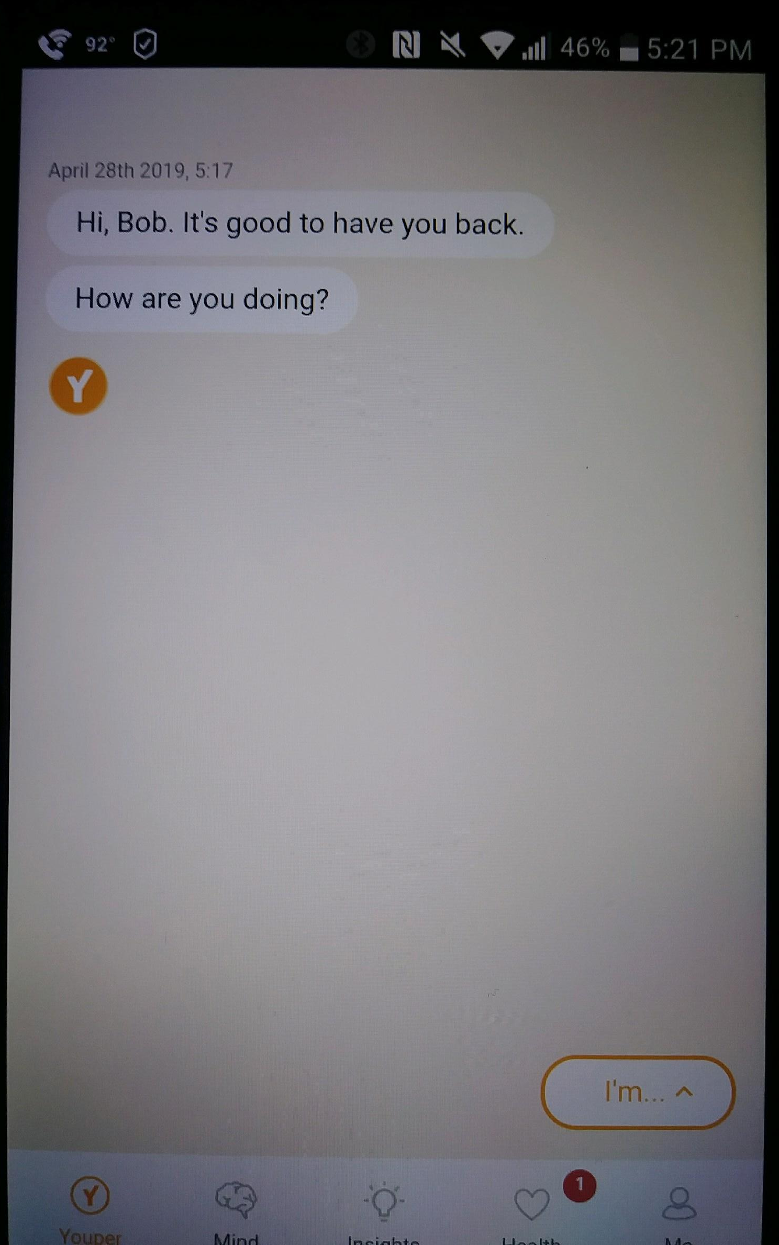
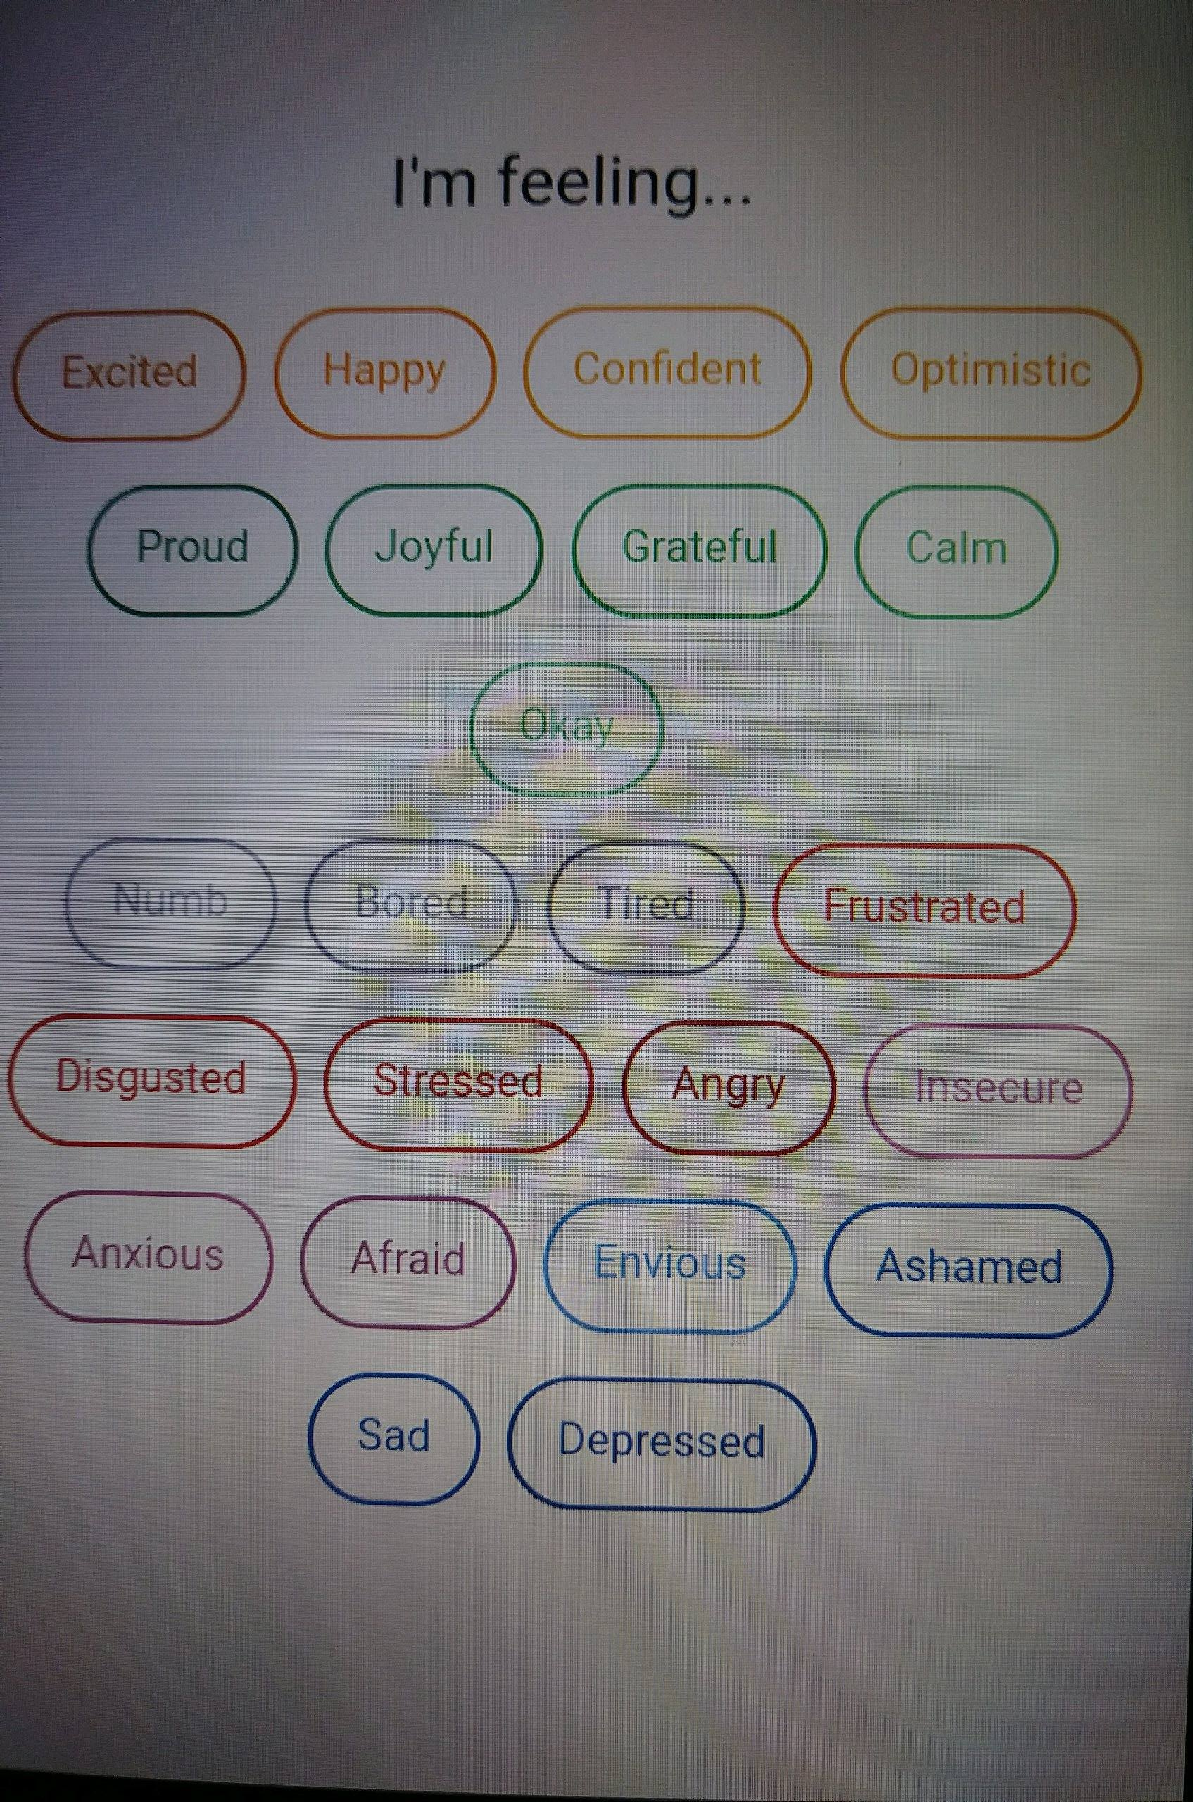
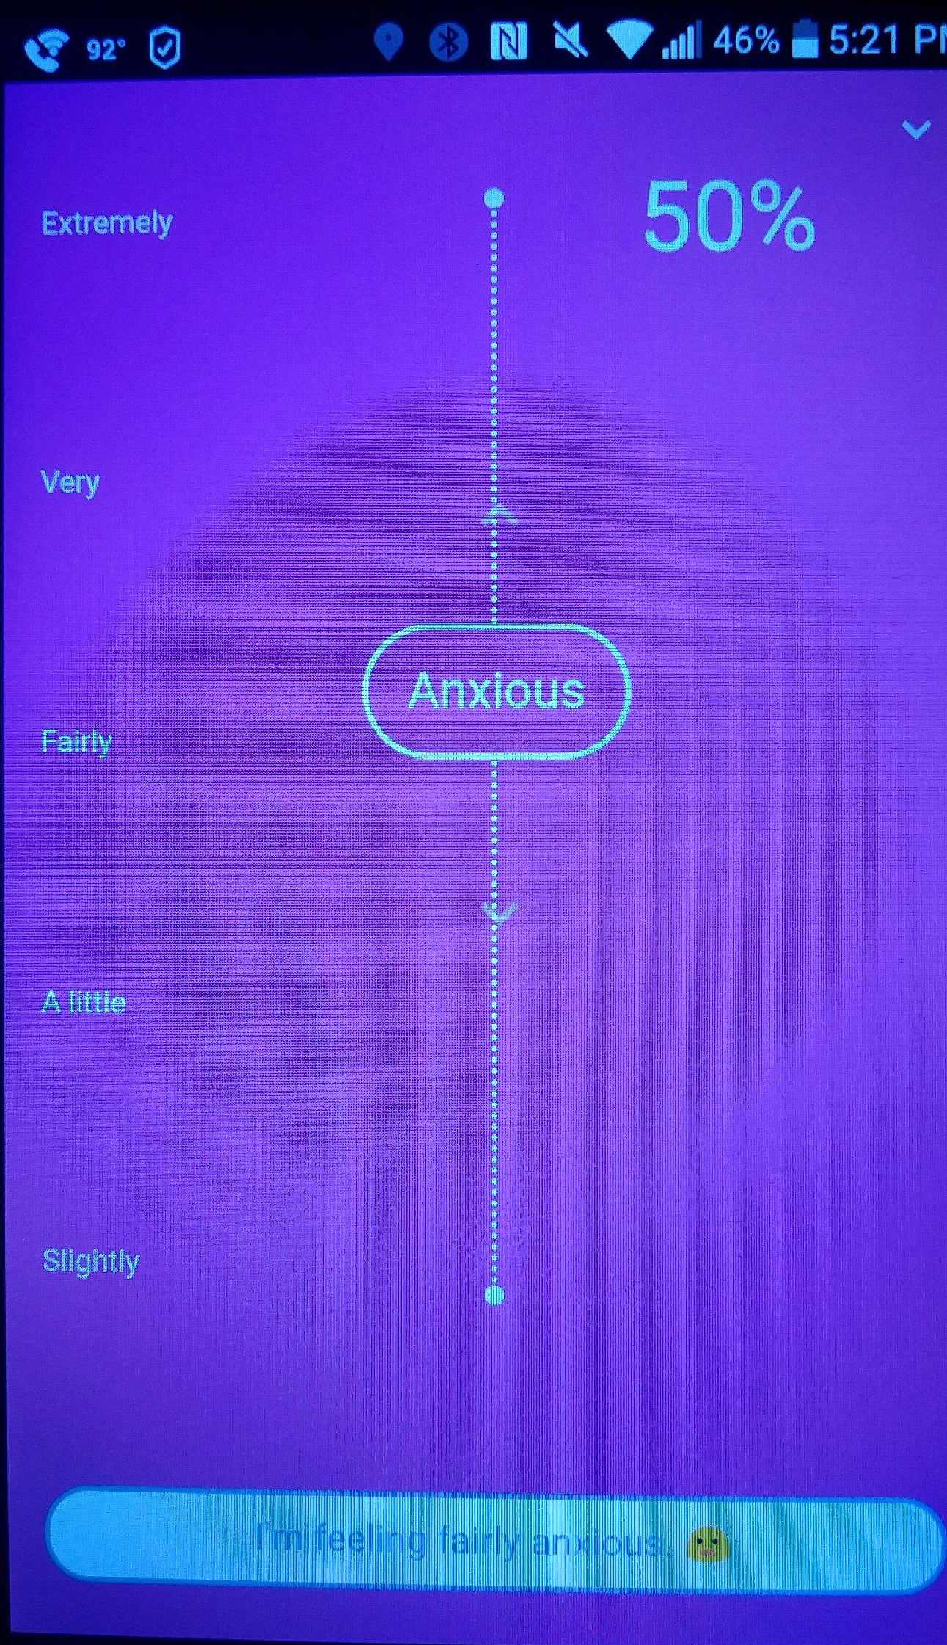
Develop your emotional intelligence.
Try using Youper (rated 4.9/5.0)

Slide 16
It all starts with……..
The benefit of boundaries
Learn to say “no”
Learn to leave work at work
Stick to activities that help you to rejuvenate
YOU!

Slide 17
The power of…
e.Y.e.
each other

Slide 18
The power of eachother…
e.Y.e.
“Human health – both psychological and physical – is inextricably tied to our close relationships. A mountain of evidence demonstrates that high-quality social relationships are positively associated with increased life satisfaction and psychological wellbeing, and negatively associated with illness and death from a range of diseases.”
Dr. David Sbarra
Department of Psychology
The University of Arizona

Slide 19
The power of each other…
Article:
The Loneliness Epidemic
1 in 4 Americans report that they rarely or never feel they have close friends or family that really understand them.
Minister for loneliness in UK
According to a study conducted at BYU, loneliness is associated with a 26% increase in mortality risk.
e.Y.e.

Slide 20
The power of each other…
Evidence: From the Journal of Burnout Research (2015)
Survey of 1624 Canadian healthcare providers
e.Y.e.
Supervisor/
Co-worker
Incivility & Distrust
Burnout

Slide 21
e.Y.e.
external resources

Slide 22
Utilize external Resources
A study conducted in 2012 of 4,402 medical students that exercised regularly found:
Rates of burnout that were significantly lower than those that did not exercise.
and
Reported overall ratings of Quality of Life (QOL) to be significantly higher.
e.Y.e.

Slide 23
Utilize external Resources
The following are some examples of external
resources you can try to decrease stress and limit
the likelihood of burning out:
Regular Exercise
Practice Mindfulness (at work or at home)
Qi Gong or Tai Chi
Yoga
Meditation Groups or guided imagery
The power of the breath (Air is Free!!)
e.Y.e.

Slide 24
Mindfulness Activity
What does it mean to practice mindfulness?

Slide 25
Maslach Burnout
Inventory
Areas of Worklife
Survey

Slide 26
“Mismatches” = potential seeds for Burnout
Mismatches typically occur between an employee and an organization in 6 possible areas:
Workload
Control
Rewards
Community
Fairness
Values
Maslach’s extensive research in
the area of burnout has revealed:

Slide 28
Preventing Burnout
Connecting with, supporting & caring for:
eachother
Knowing and Practicing self-care for:
Yourself
Utilizing existing, and trying out new
external resources

Slide 29
Questions to consider moving forward
Individually: If you were to commit to the practice of one new resource/ activity, what might that be?
Group/Department: Knowing that incivility and distrust within the workplace can contribute to higher rates of burn out, what is one way in your opinion that your workgroup or department can develop/improve trust, connection and support of one another?

Slide 30
520-621-2493
Employee Assistance Counseling
Up to 6 sessions/ year (for benefits eligible employees)

Slide 31
References
Ahola, K, Toppienen-Tanner, S. & Seppanen, J. (2017). Interventions to alleviate burnout symptoms and to support return to work among employees with burnout: Systematic review and meta-analysis. Burnout Research, 4, 1-11.
Bakker, A. & Costa, P. (2014). Chronic job burnout and daily functioning: A theoretical analysis. Burnout Research, 1, 112-119.
Dyrbye, L., Satele, D. & Shanafelt, T. (2017). Healthy Exercise Habits are Associated with Lower Risk of Burnout and Higher Quality of Life among U.S. Medical Students. Academic Medicine, 92, 1006-1011.
Leiter, M. P., Day, A. & Price L. (2015). Attachment styles at work: Measurement, collegial relationships, and burnout. Burnout Research, 2, 25-35.
Maslach, C. & Leiter, M. (2016). Understanding the burnout experience: recent research and its implications for psychiatry. World Psychiatry, 15, 103-111.
Sbarra, D.A. & Coan, J.A. (2018). Relationships and Health: The Critical Role of Affective Science. Emotion Review, 10, 40-54.

Slide 32
Thank You!
e. Y. e.

