Slide 1
Budget Line Cleaning
Best Practices and Tips

Slide 2
UAccess Analytics
What report do I use?
Line research & correction report
vs
Expenditure Authority report

Slide 3
UAccess Analytics
Line research & correction report
New dashboard created to only show lines out of balance

Slide 4
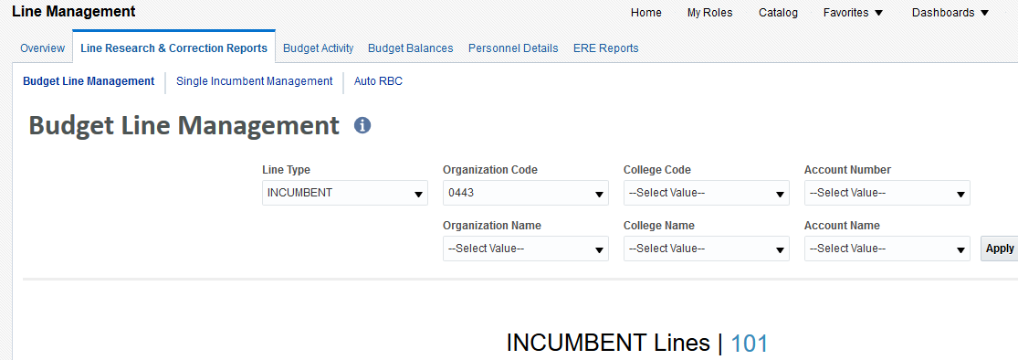
UAccess Analytics

Slide 5
UAccess Analytics
Expenditure Authority report
Gives all the details of your budget lines
I strongly suggest using this report

Slide 6
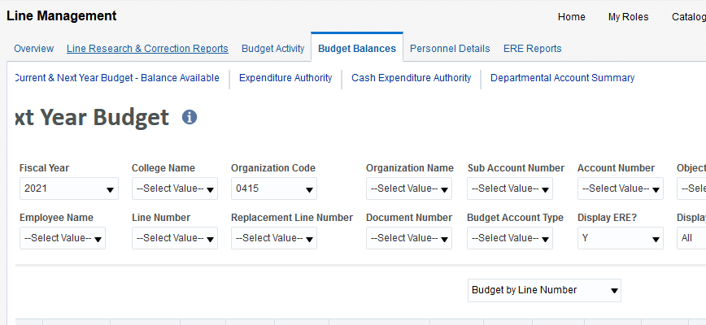
UAccess Analytics

Slide 7
Analytics
How to read the reports
Budget Balance Available = TEMP
(Perm) Next Yr Budget = PERM
Object code lines
If a person is new, or has new position, will be found in these lines
No object codes in new report

Slide 8
Analytics
How to read the reports
Temp teaching found in 902
Carryforward lines – 903 & 3001
Must change line type to “COMMITMENT/SAVINGS” in new report

Slide 9
Analytics
Only Budget accounts will have line numbers associated with them
No local, grants, etc.
PERM
Should be the person’s annualized salary
Possibly less if split funded
TEMP
Goal is to get this should be zero

Slide 10
Analytics
Negative TEMP
Possibly a distribution issue
Could be the person was hired late/not paid
Salary Increases
Salary Calculator to determine amount

Slide 11
Analytics
Positive TEMP
Course buyouts/leave
Position distribution issue
Possibly the person was overpaid
Contact payroll and the employee
They will have to pay it back!

Slide 12
Budget System

Slide 13
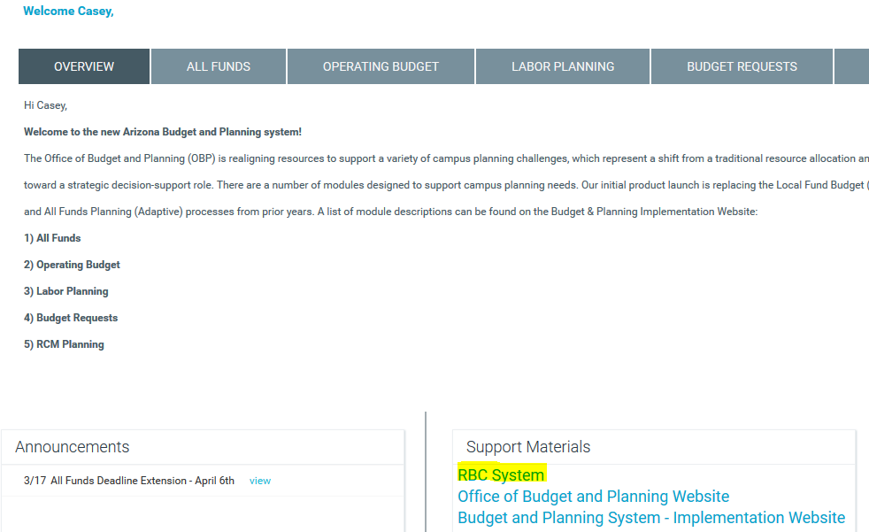
Budget System

Slide 14
Budget System
Fill out the entire form

Slide 15
Budget System
Comments are helpful for non-routine transfers
“Funding Grad for full year, amount will not match line deficit”

Slide 16
Budget System
Tips for RBCs (continued)
Please keep them to 10-12 lines max:

Slide 17
Budget System
Tips for eRBCs
Can save before routing
Good to double check for mistakes
If incorrect after routed, can edit draft
Best to delete drafts in system periodically

Slide 18
Budget System
Numbering lines
Delete VACANT lines
Does not delete PCN, just frees up that line
Good to have an organizational approach
Start with head, then faculty, staff, grads, misc.
Also helpful if these are alphabetical

Slide 19
Budget System
Creating lines
Want to double check to make sure no position number is associated before using
Can create line here, or can fund and create line at the same time

Slide 20
Budget System
Budget lines can only have 1 position number
Can have multiple accounts
Can have multiple object code

Slide 21
Budget System
Use decimals for multiple lines for one person
i.e. department heads OPS
Pl
ease only use decimals for the same person

Slide 22
Budget System
Looking up RBCs
Can only look at the previous RBCs you created under view/edit RBC tabs
Can look up all RBCs submitted for a certain line

Slide 23
Questions?

